Slide 1
Multi-agent structures
Evaluation

Slide 2
Challenges

Slide 3
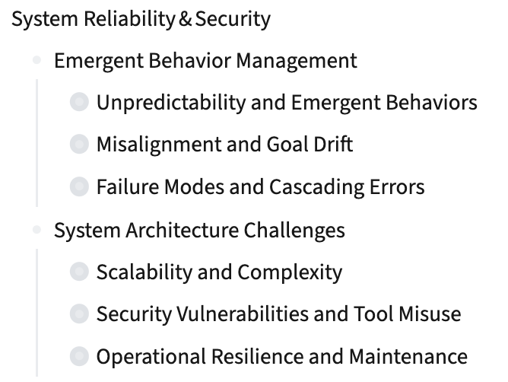

Slide 4
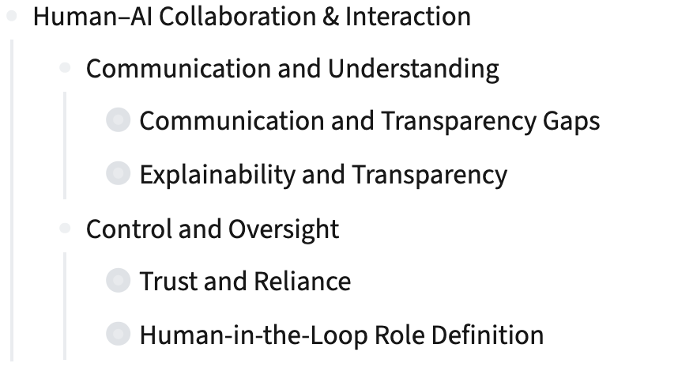

Slide 5
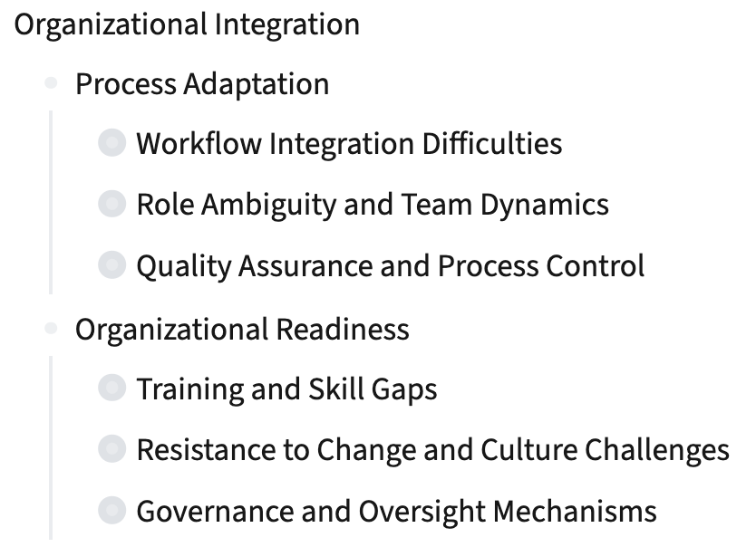

Slide 6
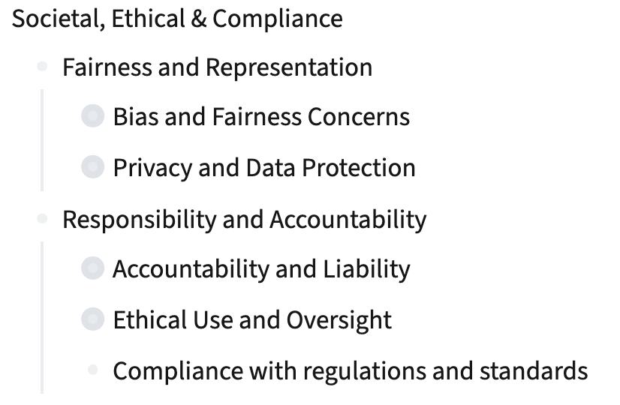

Slide 7
Evaluation Framework
Challenges > Metrics

Slide 8
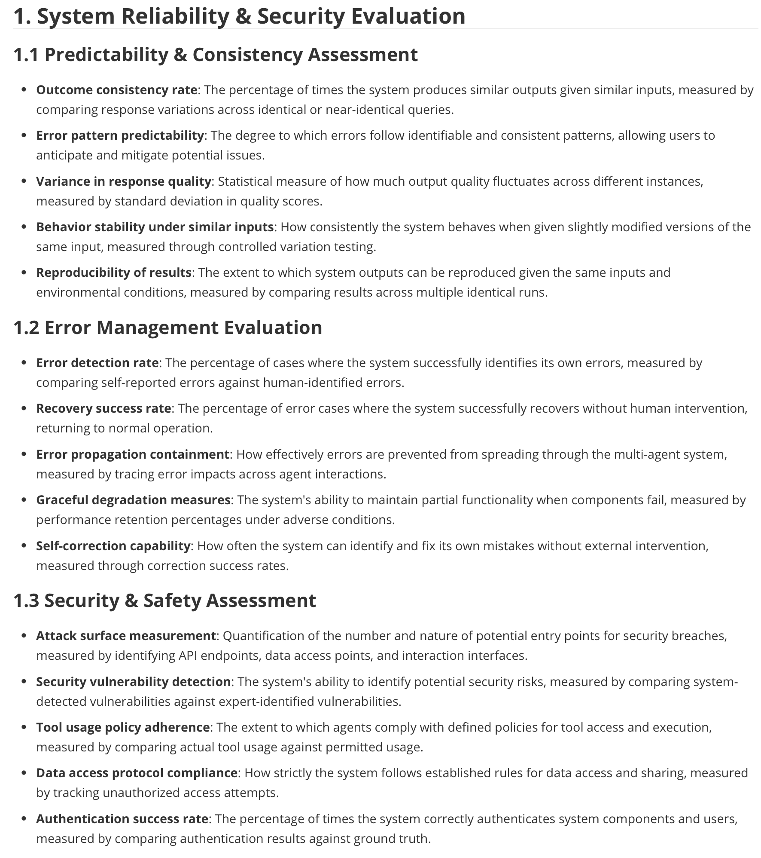

Slide 9
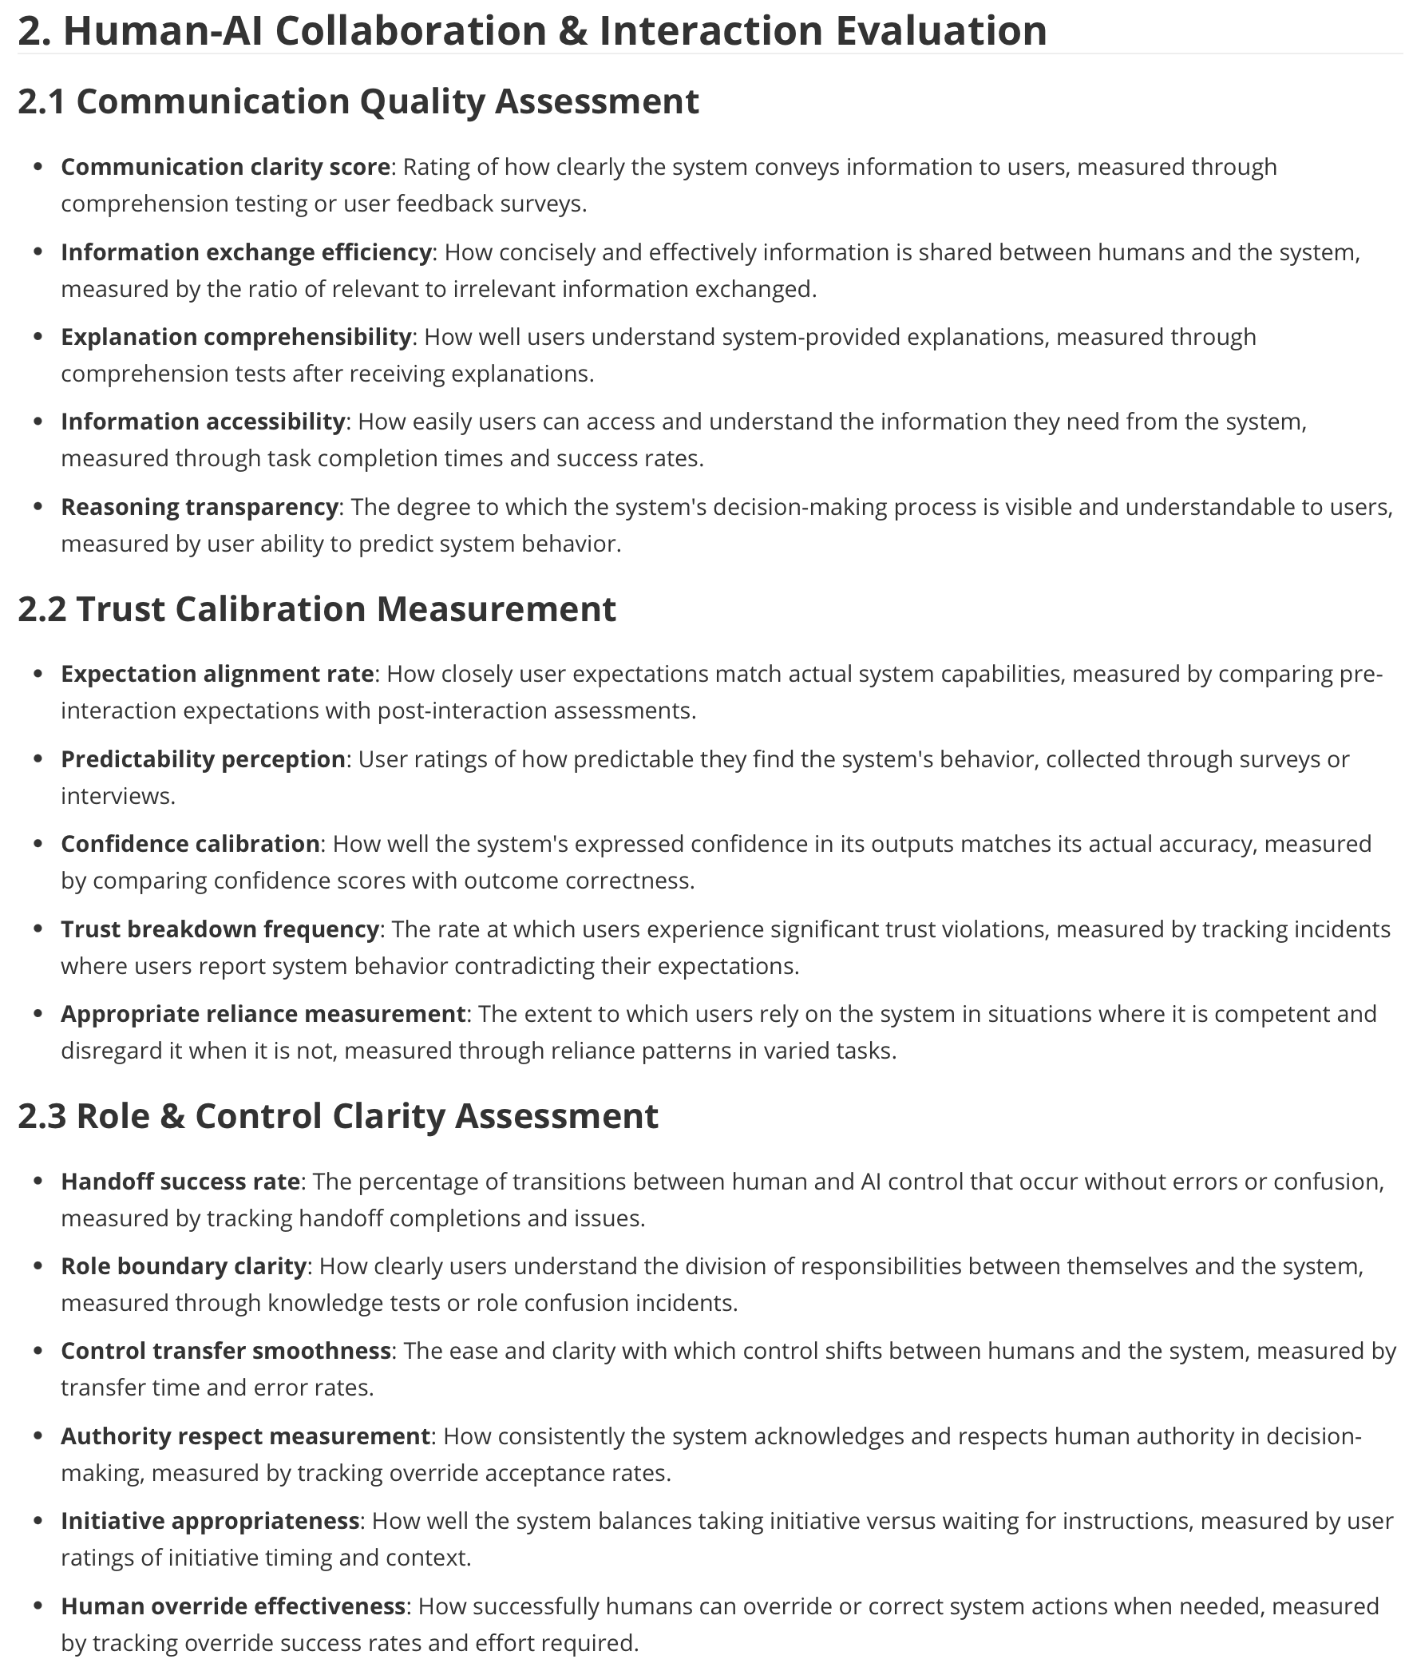

Slide 10
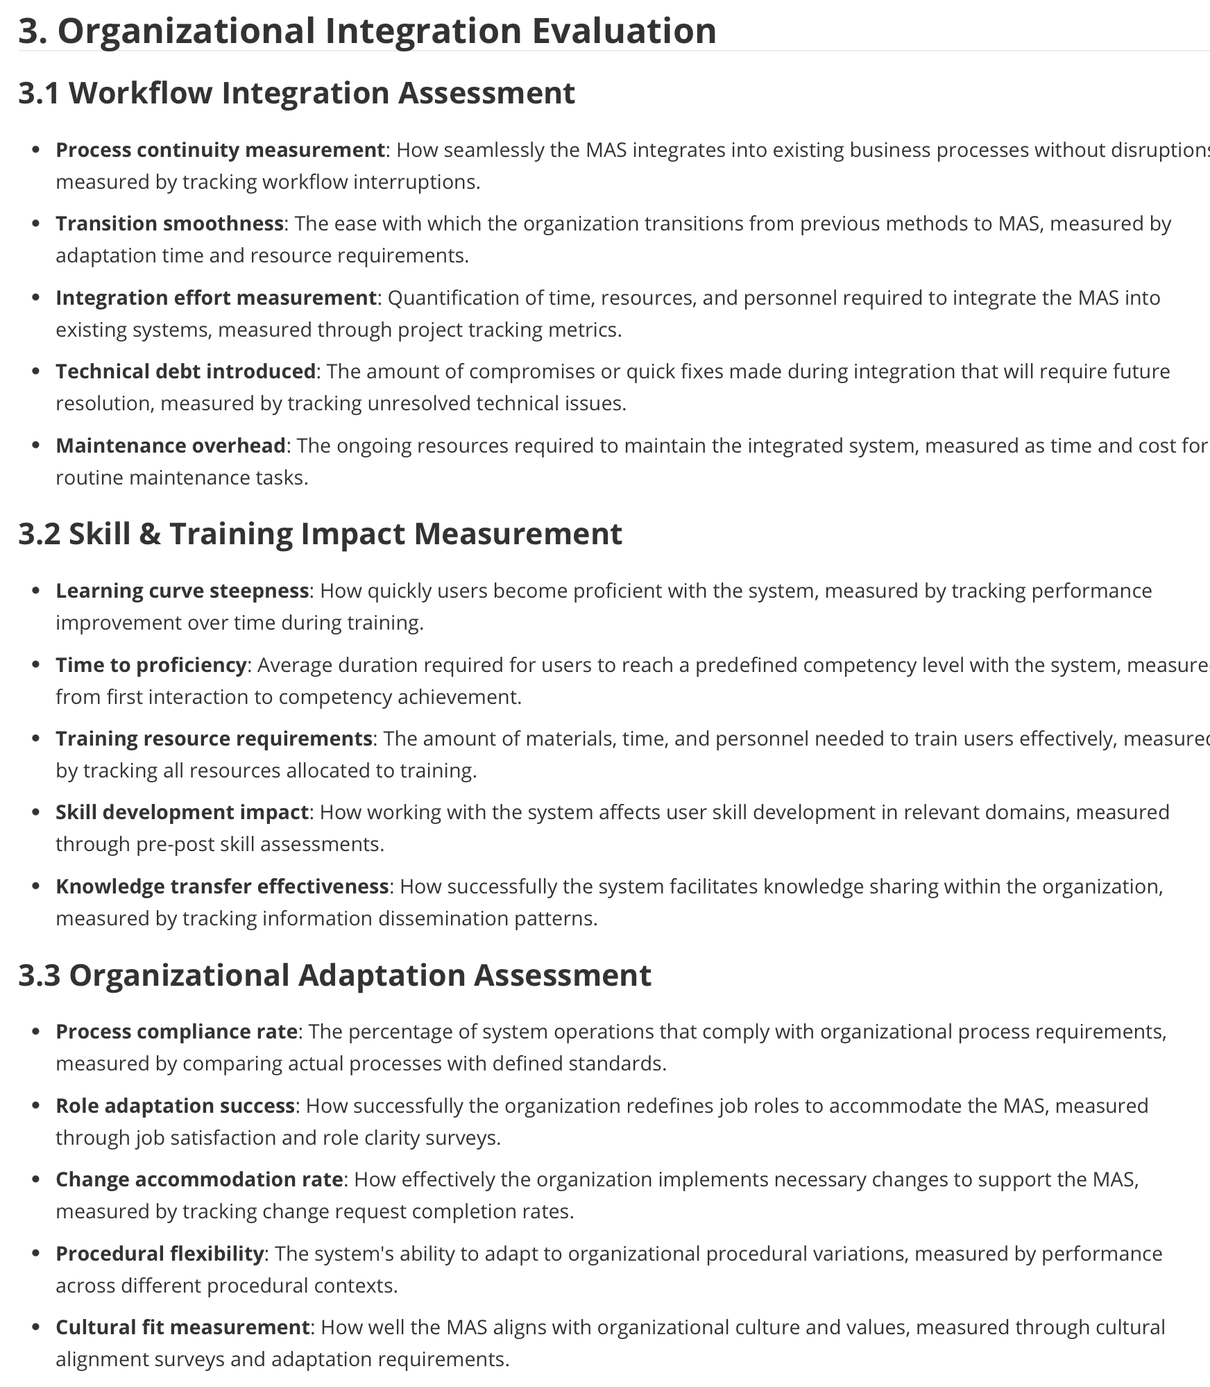

Slide 11
